Slide 1


Slide 2

We convert life insurance from one of the least valuable properties in a portfolio to one of the most valuable properties…

Slide 3
We convert life insurance from one of the least valuable properties in a portfolio to one of the most valuable properties…
Without selling life insurance.

Slide 4
Using our proprietary, fee-based, fiduciary level, advisory services
We convert life insurance from one of the least valuable properties in a portfolio to one of the most valuable properties…
(independent of life insurance company illustrations).

Slide 5
Using the principles found in Life Insurance Property Management LIPM™ which we created, perfected and make available through…
The ObjectiView System.

Slide 6
Where there is a clear need and desire for immediate additional liquidity when someone dies, we believe…

Slide 7
Where there is a clear need and desire for immediate additional liquidity when someone dies, we believe…
Life Insurance, when properly acquired and managed, is the best type of property ever invented for the creation and transfer of wealth.

Slide 8
When life insurance is not properly acquired or managed, chances are… policy owners are not getting what they paid for and could even lose their entire investment.

Slide 9
But when properly acquired and managed, life insurance works…

Slide 10
Because…
You pay “pennies on the dollar”!
A small investment is exchanged for a much larger cash payment when it is needed most.
e.g.: Approx. $2.5 million annual premium in exchange for a $100 million death benefit

Slide 11
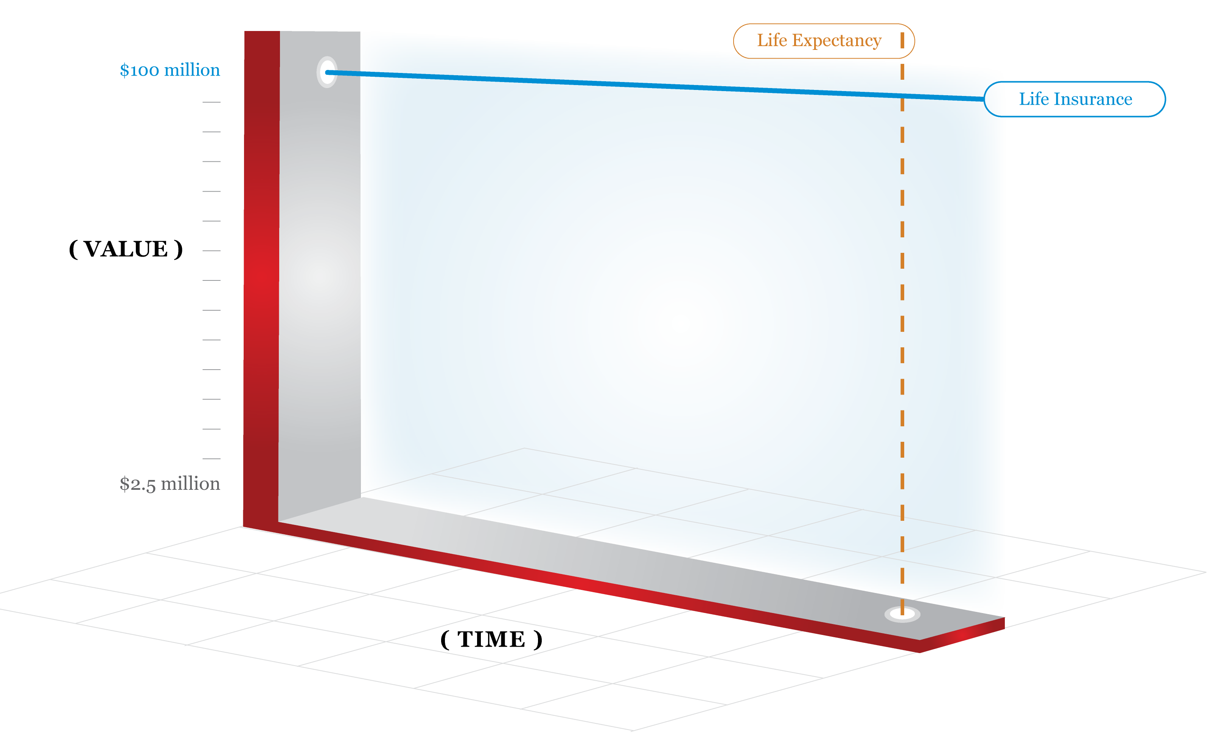
What people think they are buying…

Slide 12
But, what they probably own - because they bought it and forgot it - is an asset with a high probability of experiencing compounding deterioration.
Which means…

Slide 13
Upwards of 90% of the time…
the policies are failing!

Slide 14
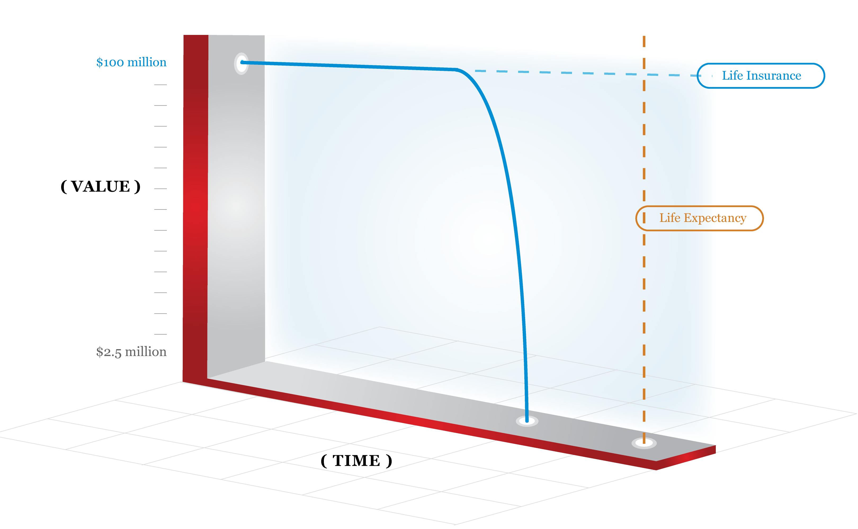
Their policies die before they do!

Slide 15
But…
we have found there is a 75% probability they own a good policy, with valuable property rights that have not been fully utilized.

Slide 16
Making life insurance work…
Properly acquired and managed life insurance, generally provides a rate of return much higher than most other assets, up to life expectancy.
And, it is competitive even beyond life expectancy.

Slide 17
Making life insurance work…
Life Insurance provides an immediate return that is… extraordinary!

Slide 18
Can you do better?
Other forms of property can outperform insurance…
if there is enough time!

Slide 19
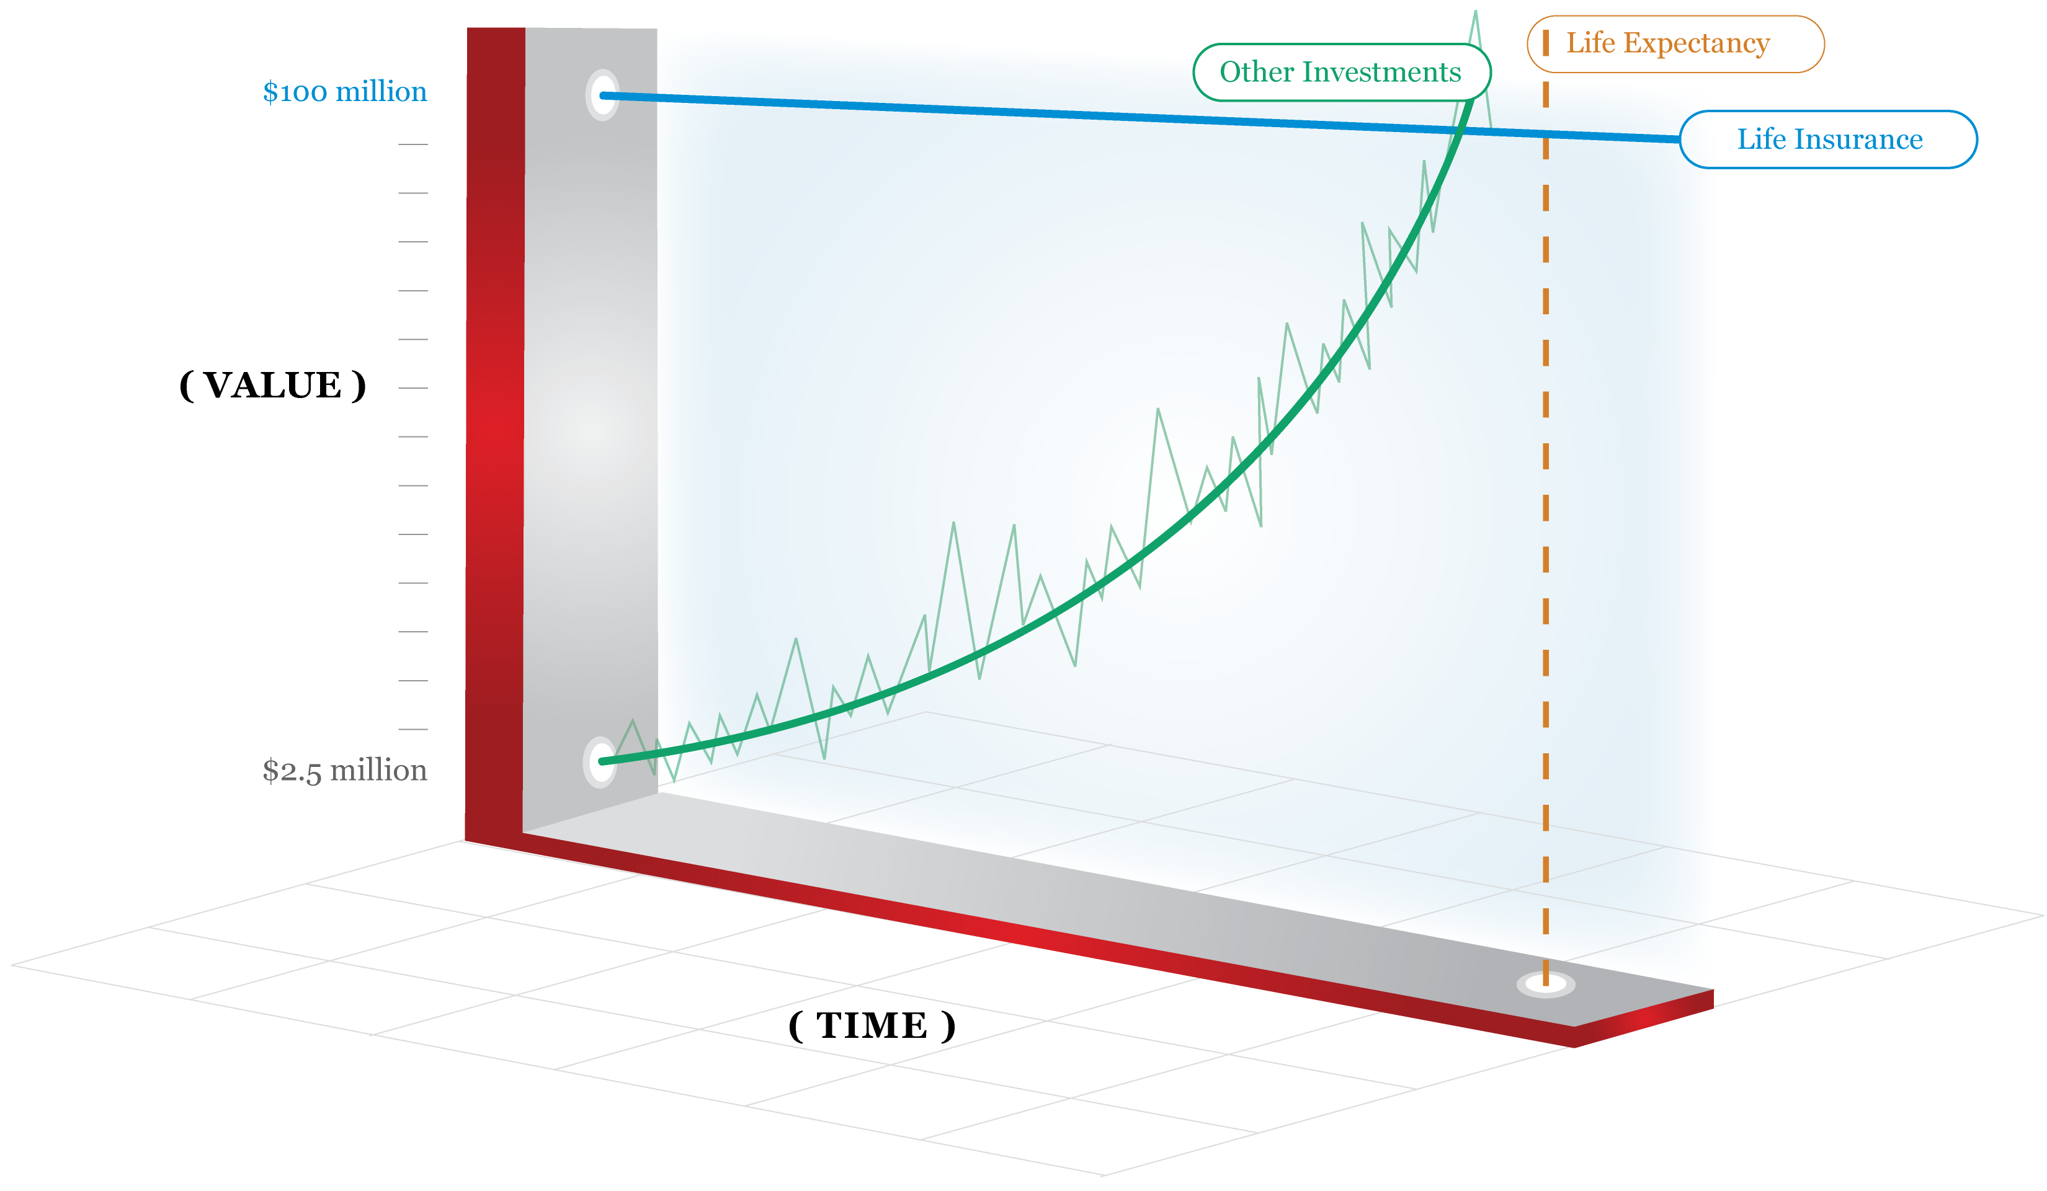
Other property: Timing is critical

Slide 20
Our sole purpose:
Optimize the return on invested capital at the termination of the policy

Slide 21
How do we do it?
By combining and professionally managing two proprietary, actuarial technologies over time.

Slide 22
How do we do it?
By combining:
The personalized life expectancy of the insured with,
The optimization of the
unique property rights within each policy

Slide 23
How do we do it?
By combining personalized life expectancy and optimization of property rights…
Within the ever-changing financial and emotional constraints of the policy owner.

Slide 24
In fact…
The ObjectiView System is the only system available for optimizing performance over the life of a policy.

Slide 25
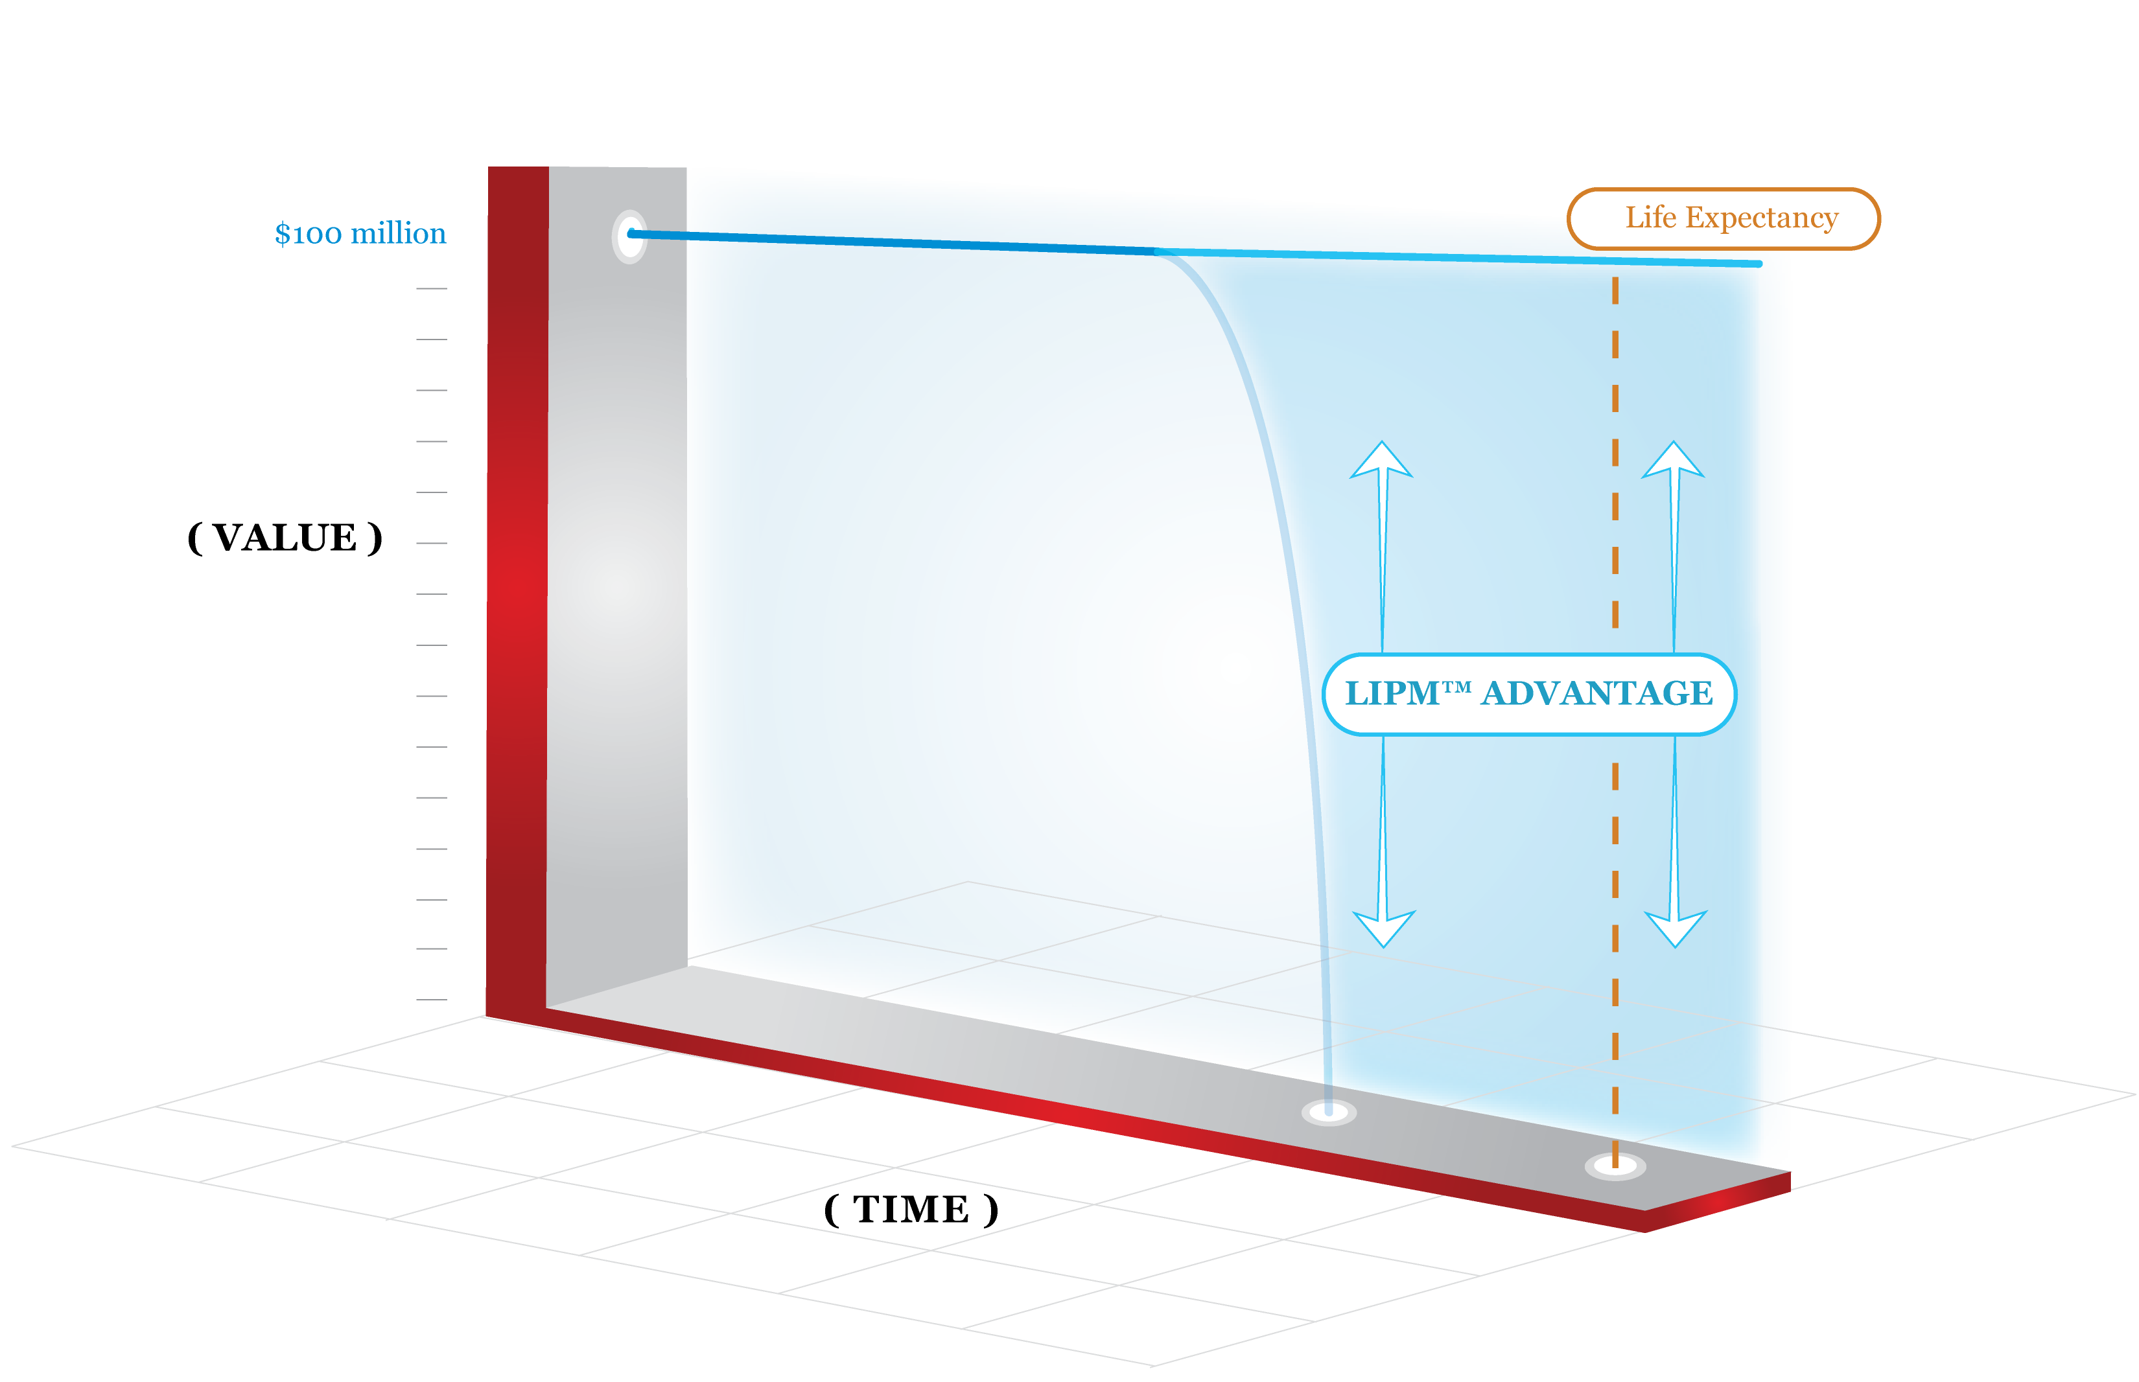
Apply The ObjectiView System early enough

Slide 26
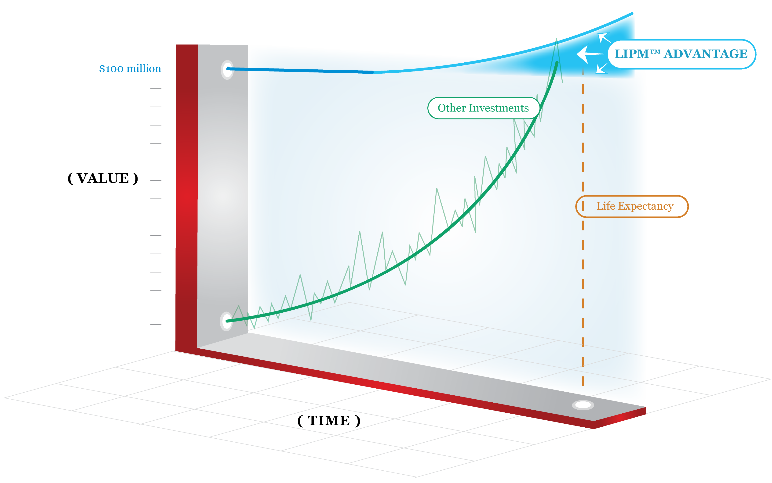
Apply The ObjectiView System before you buy

Slide 27
The ObjectiView System:
The best way to ensure life insurance has the highest probability of providing the highest return when it matters most.

Slide 28

The ObjectiView System
#1: The Alignment Interview Clarify life insurance goals and explore the ObjectiView Options that fit you best.
#2: Personal LIPM™ Protocol
A detailed road map for
achieving your goals.
#4: Portfolio Performance Management
Ongoing management ensuring
portfolio is on target with Personal LIPM™ Protocol
#3: The Portfolio Builder Create a new life insurance property portfolio or remodel an existing one to exactly fit your Personal LIPM™ Protocol

Slide 29
Are we a right fit for you? Are you a right fit for us?
Find out!
Watch our case studies
Attend our webinars
Subscribe to Pace’s Pig-in-a-Poke
Ask for a case-specific Real Value Snapshot
Schedule an Alignment Interview

